Slide 1
Keyword: source code
Summarization
Commit

Slide 2
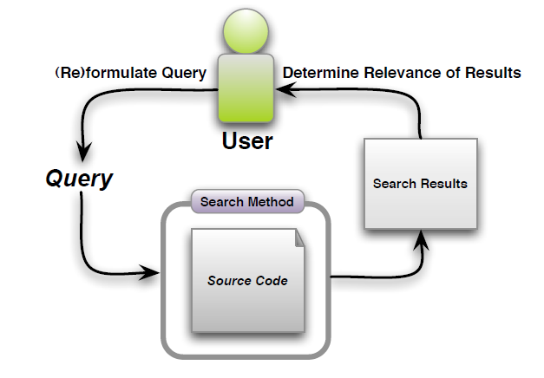
ICSE2009-Automatically Capturing Source Code Context of NL-Queries for Software Maintenance and Reuse
Key point: query
Automatically extracts natural language phrases from source code identifiers and categorizes the phrases and search results in a hierarchy.

Slide 3
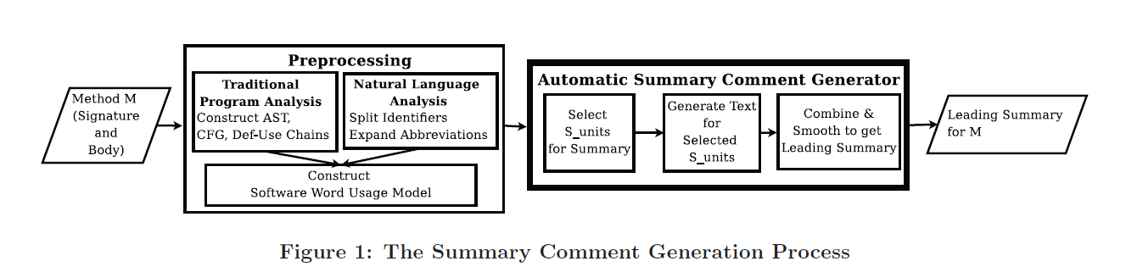
ASE2010 Towards automatically generating summary comments for JAVA methods
SWUM：capture the occurrence of words in code and their linguistic and structural relationships.
S_unit selection: choose the important or central lines of code to be included in the summary
Ending S_units, Void-Return S_units, Same-Action S_units, Data-Facilitating S_units, Controlling S_units
针对不同的S_unit有不同的生成策略 + 一些省略策略

Slide 4
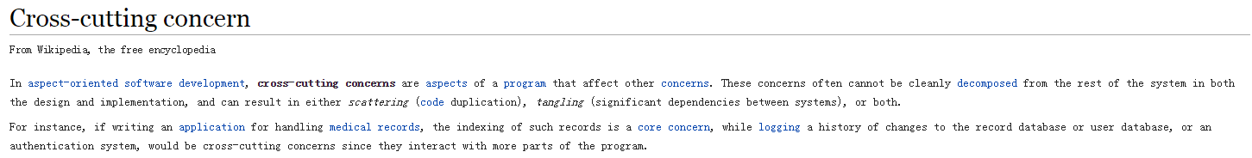
ICSM2010 Generating Natural Language Summaries for Crosscutting Source Code Concerns
Describe both what the concern is and how the concern is implemented.
First, we extract structural and natural language information from the source code.
Second, we apply a set of heuristics to the extracted information to find patterns and
identify salient code elements in the concern code.
Finally, using both the extracted information and the content produced from the
heuristics, we generate the sentences that form the summary.

Slide 5
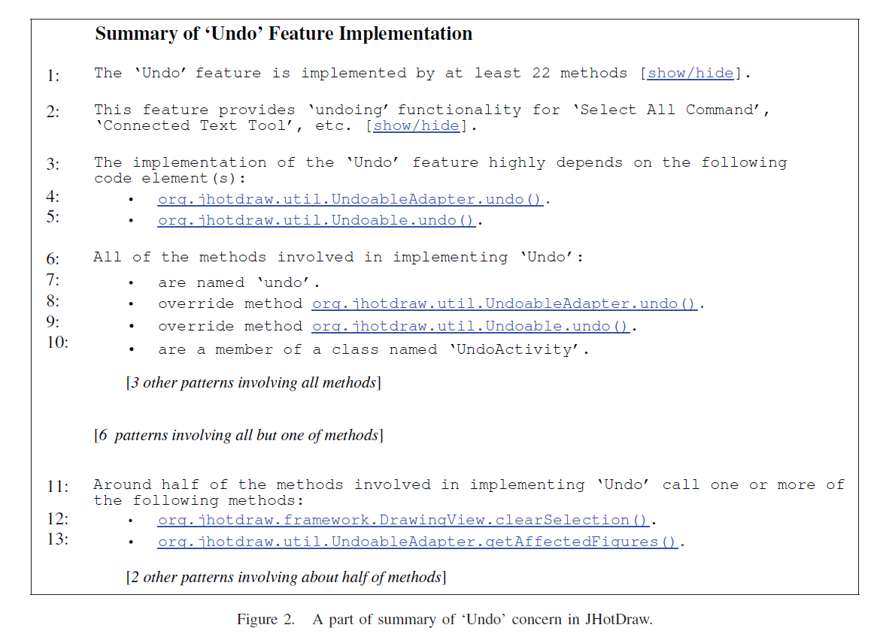
ICSM2010 Generating Natural Language Summaries for Crosscutting Source Code Concerns

Slide 6
NLDB2010-Automatic quality assessment of source code comments
Present an effective and automated approach for assessing the quality of inline documentation using a set of heuristics, targeting both quality of language and consistency between source code and its comments.

Slide 7
WCRE2010-On the Use of Automated Text Summarization Techniques for Summarizing Source Code
Study a solution to illustrate the software entities without having to read the details of the implementation.
Two main challenges: determining what should be included and how to generate them automatically.

Slide 8
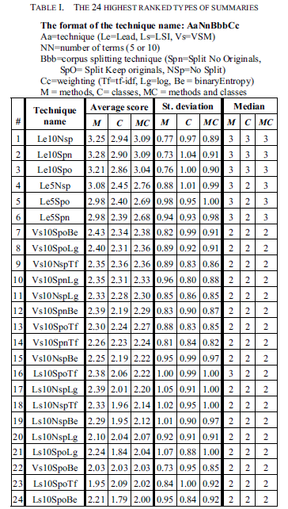
WCRE2010-On the Use of Automated Text Summarization Techniques for Summarizing Source Code
A combination between techniques making use of terms in software and TR techniques capture the meaning of methods and classes better than any other of the studies approach.
Future work: structural information.

Slide 9
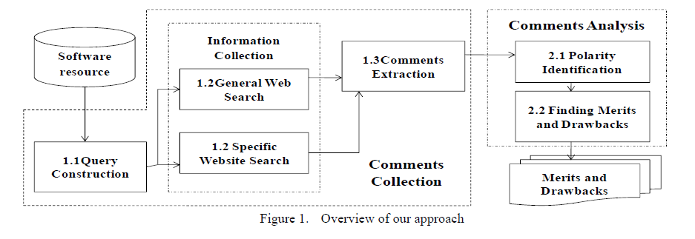
ASE2011 Finding the merits and drawbacks of software resource from comments
整体如上，通过在网络上搜寻有关代码的评论，分析其极性来得到其优缺点。

Slide 10
2012 Automated Feature Discovery via Sentence Selection and Source Code Summarization
通过大量不同方法的实验对比明确指出句子选择策略摘要的不足。
结论：句子选择策略不足以完成较好的摘要（LDAmodel抽取主题有较好的效果）；文本分析方法着重于结构和顺序，而程序，尤其是method通常是无序的，因此研究methods之间的交互是一个非常重要的点（high-level information）。

Slide 11
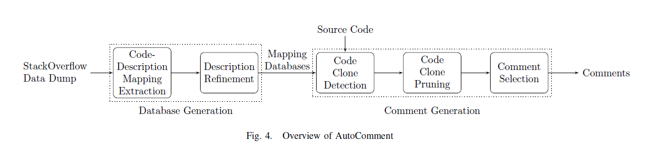
ASE2013 AutoComment: Mining Question and Answer Sites for Automatic Comment Generation

Slide 12
ICPC2013 automatic generation of natural language summaries for JAVA classes
重点：content and responsibilities rather than their relationships with other classes
methods上的方法不能直接套用
the type of methods and their distribution in a class
selected elements:
set1: do not need any analysis, the name of interfaces, superclass and inner classes.
set2: need analysis, class attributes and methods
class stereotype are high level abstractions that describe the role or responsibility of classes in a system.

Slide 13
ICPC2013 automatic generation of natural language summaries for JAVA classes
step1: stereotype identification
method stereotype: 5 kinds, AST and some additional info.
class stereotype: 13+
step2: heuristics for content selection. 2 filters.
step3: text generation: general description, stereotype description, behavior description, inner class enumeration.
评价：人工评价，3种指标：adequacy, conciseness, expressiveness.
future work: enrich stereotype identification, consider relationships to classes, comments.

Slide 14
ICPC2013 Quality Analysis of Source Code Comments
This work presented a first detailed approach for the analysis and assessment of code comments. The model describes detailed quality attributes in terms of coherence, consistency, completeness, and usefulness.
With the coherence coefficient and the length indicator, we provided two metrics to assess quality attributes of the model and evaluated them with a survey among experienced developers.

Slide 15
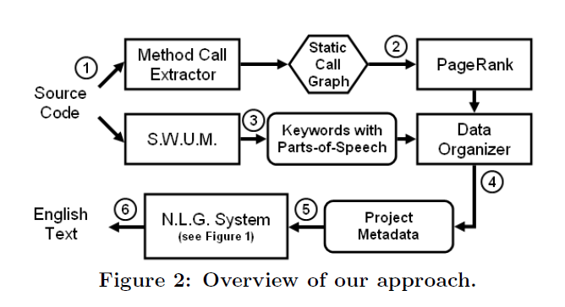
ICPC2014-Automatic documentation generation via source code summarization of method context
In this paper, we propose a technique that includes this context by analyzing how the Java methods are invoked. In a user study, we found that programmers benefit from our generated documentation because it includes context information.

Slide 16
icse2014-Improving Automated Source Code Summarization via an Eye-Tracking Study of Programmers
Problems: no studies of how programmers read and understand source code
Eye-tracking technology: gaze time, fixations, regressions.
Basic method: select top-n keywords via VSM(vector space model) tf/idf
Methodology: hypothesis testing
Conclusion: method signature > method invocation > all other areas > control flow

Slide 17
2014 p460-Selection and Presentation Practices for Code Example Summarization
Goal of the study: learn code summarization practices and their justification from human participants to inform future development in source code summarization and presentation technology. (Eye-tracking technology)
Key points: Selection and presentation
结合eye-tracking 和测试人员结果定性地分析

Slide 18
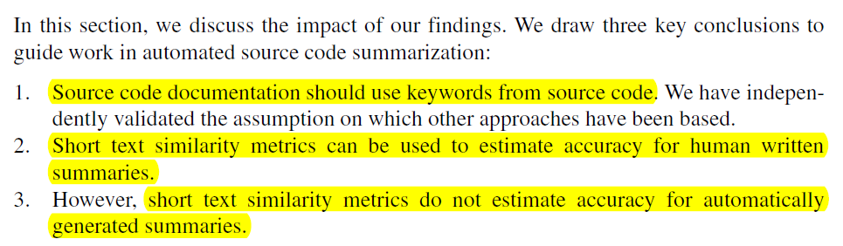
2014 An empirical study of the textual similarity between source code and source code summaries
指出自动生成的摘要更像读者角度，从原有的代码出发，没有解决读者和作者之间理解角度偏差的问题。
通过比较作者的摘要和读者的摘要来得到对自动摘要生成工具的guidelines。
method为粒度。
Overlap
STASIS
LSS

Slide 19
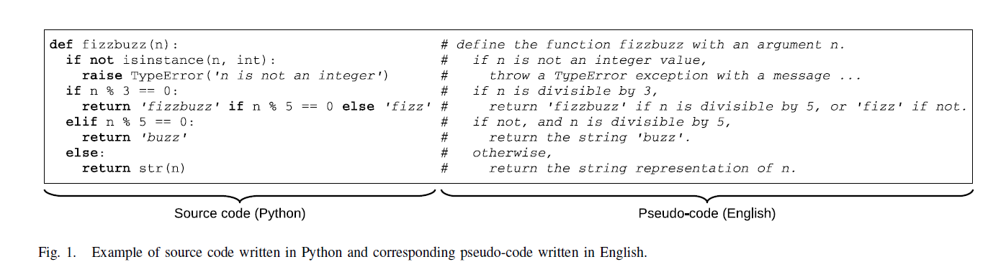
ASE2015 Learning to Generate Pseudo-code from Source Code using Statistical Machine Translation
create pseudo-code, adopting the statistical machine translation framework

Slide 20
ICSE2015-Automatic Documentation Generation via Source Code Summarization
还是针对methods
what makes a "good" source code comment
RQ1 How similar should the text in summaries be to text and keywords in the source code?
RQ2 To what degree should contextual information about code be included in summaries of that code?
RQ3 To what extent can the file structure of source code affect the quality of documentation?

Slide 21
ICSE2015-Leveraging Informal Documentation to Summarize Classes and Methods in Context
StackOverflow + Identifiers
We use the context that surrounds code elements in StackOverflow posts to summarize the use and purpose of code elements.
To provide focus to our investigation, we consider the generation of summaries for library identifiers discussed in StackOverflow.

Slide 22
分类
研究怎样才是比较好的summary，需要着重在什么信息上，提供guidelines。
针对methods或者classes从代码内部出发研究其summary，表现形式分key identifies和call information.
从代码外部出发，通过收集类似于知识库的形式对代码进行摘要。

Slide 23
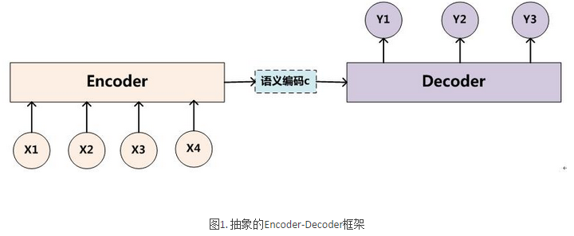



2016 A Convolutional Attention Network for Extreme Summarization of Source Code
用带attention机制的卷积神经网络来做方法名预测（method为主）
Encoder-Decoder框架

Slide 24
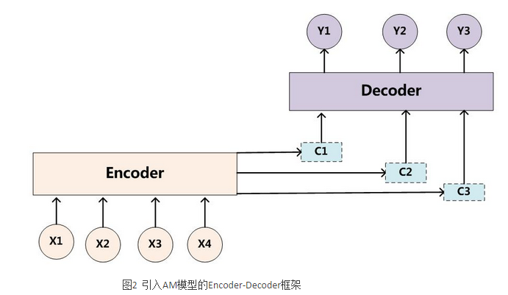

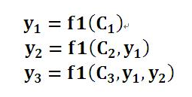
引入Attention

Slide 25
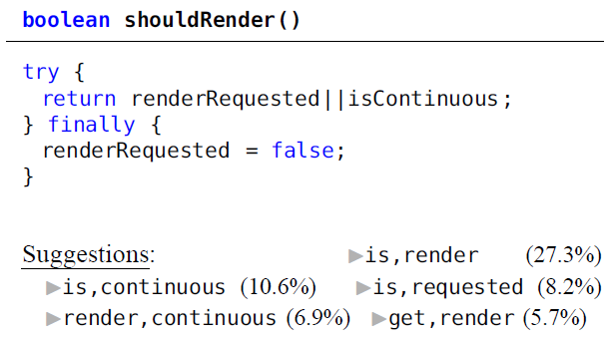


Slide 26
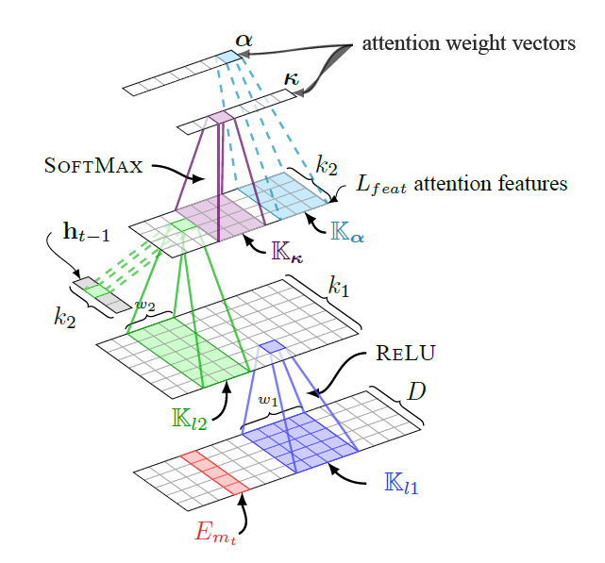
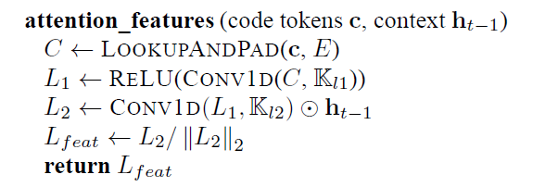

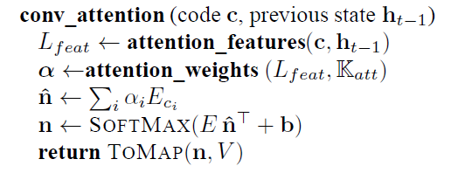

Slide 27
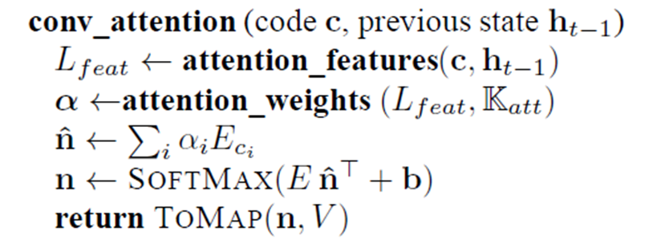
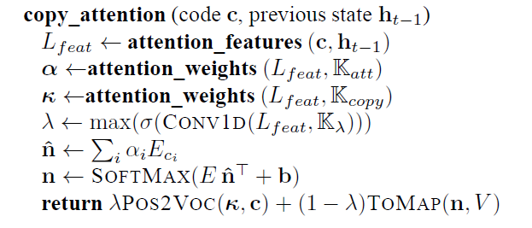
OOV?

Slide 28
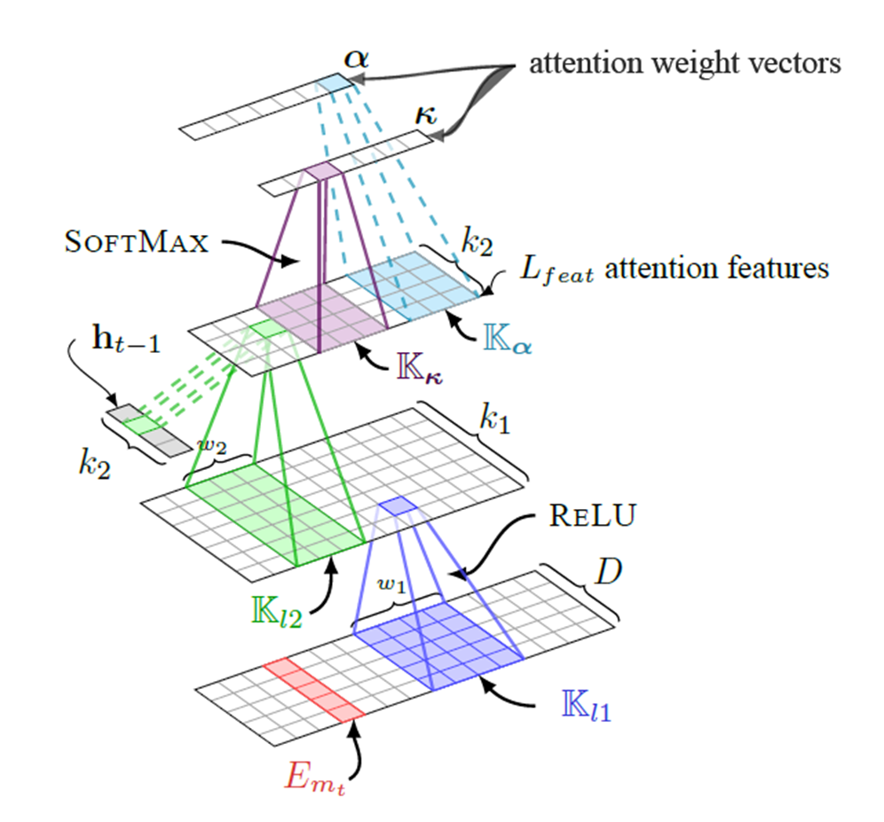
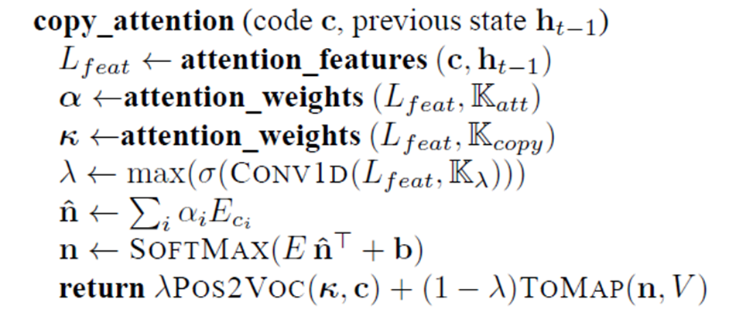
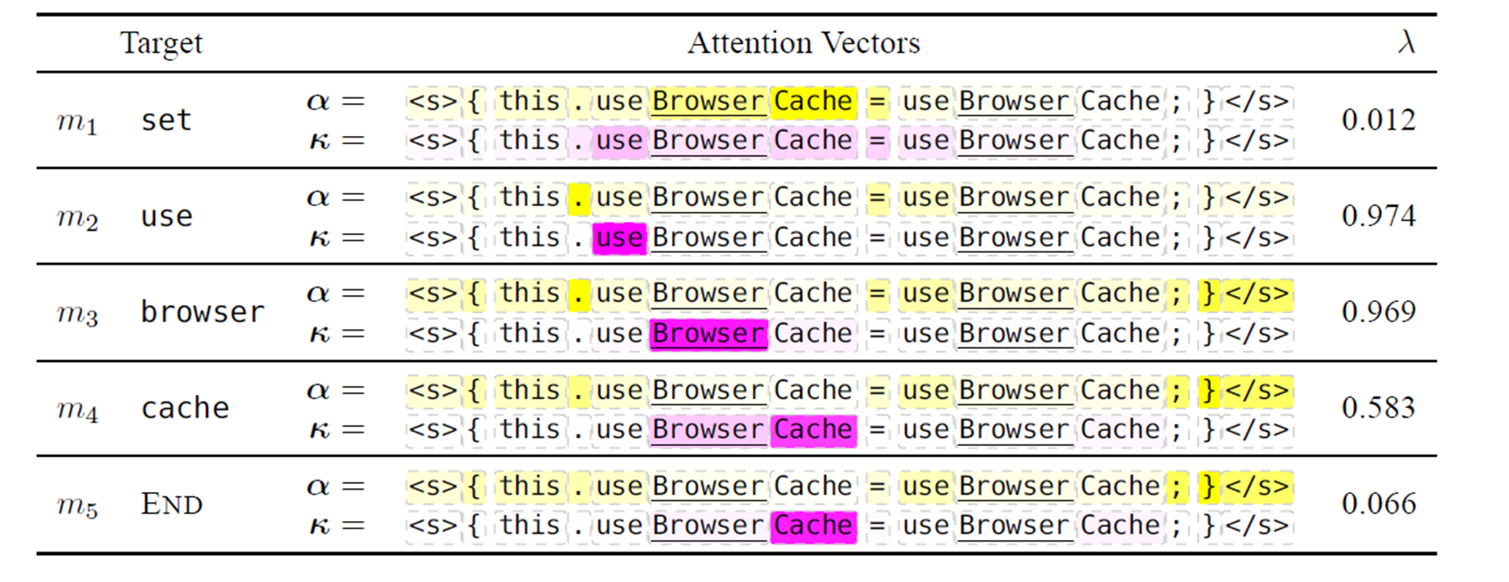
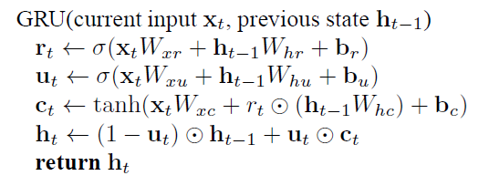


Slide 29
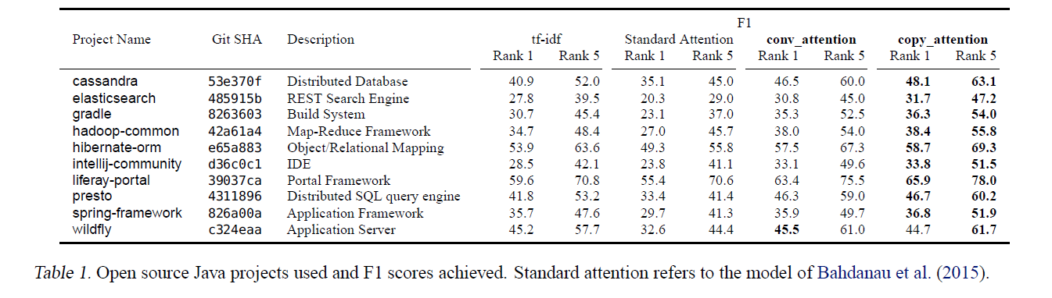
Evaluation
Dataset collection
Experimental setup
Training

